Slide 1




AIML Hackathon Presentation
CodePrep
AI-powered coding interview practice platform
Presented By:
Interview Trainer

Slide 2

The Problem
Interview Trainer
Why current coding practice tools are not enough
Most coding practice platforms focus only on correct answers
Real interviews also test communication and problem-solving process
It is hard to practice speaking and thinking aloud alone
Existing tools do not fully simulate interview pressure

Slide 3



The Solution
Users interact with an AI interviewer in real time
Coding challenges can be solved directly in the browser
I think put our project image
Different interviewer personalities create different levels of difficulty
After each session, users receive a score and detailed feedback

Slide 4

Frontend built with Next.js
How It works
Backend powered by Express and WebSocket
MySQL and Prisma for data storage
OpenAI Realtime API for live interview interaction
OpenAI Realtime API for live interview interaction
Sandbox environment safely runs submitted code

Slide 5
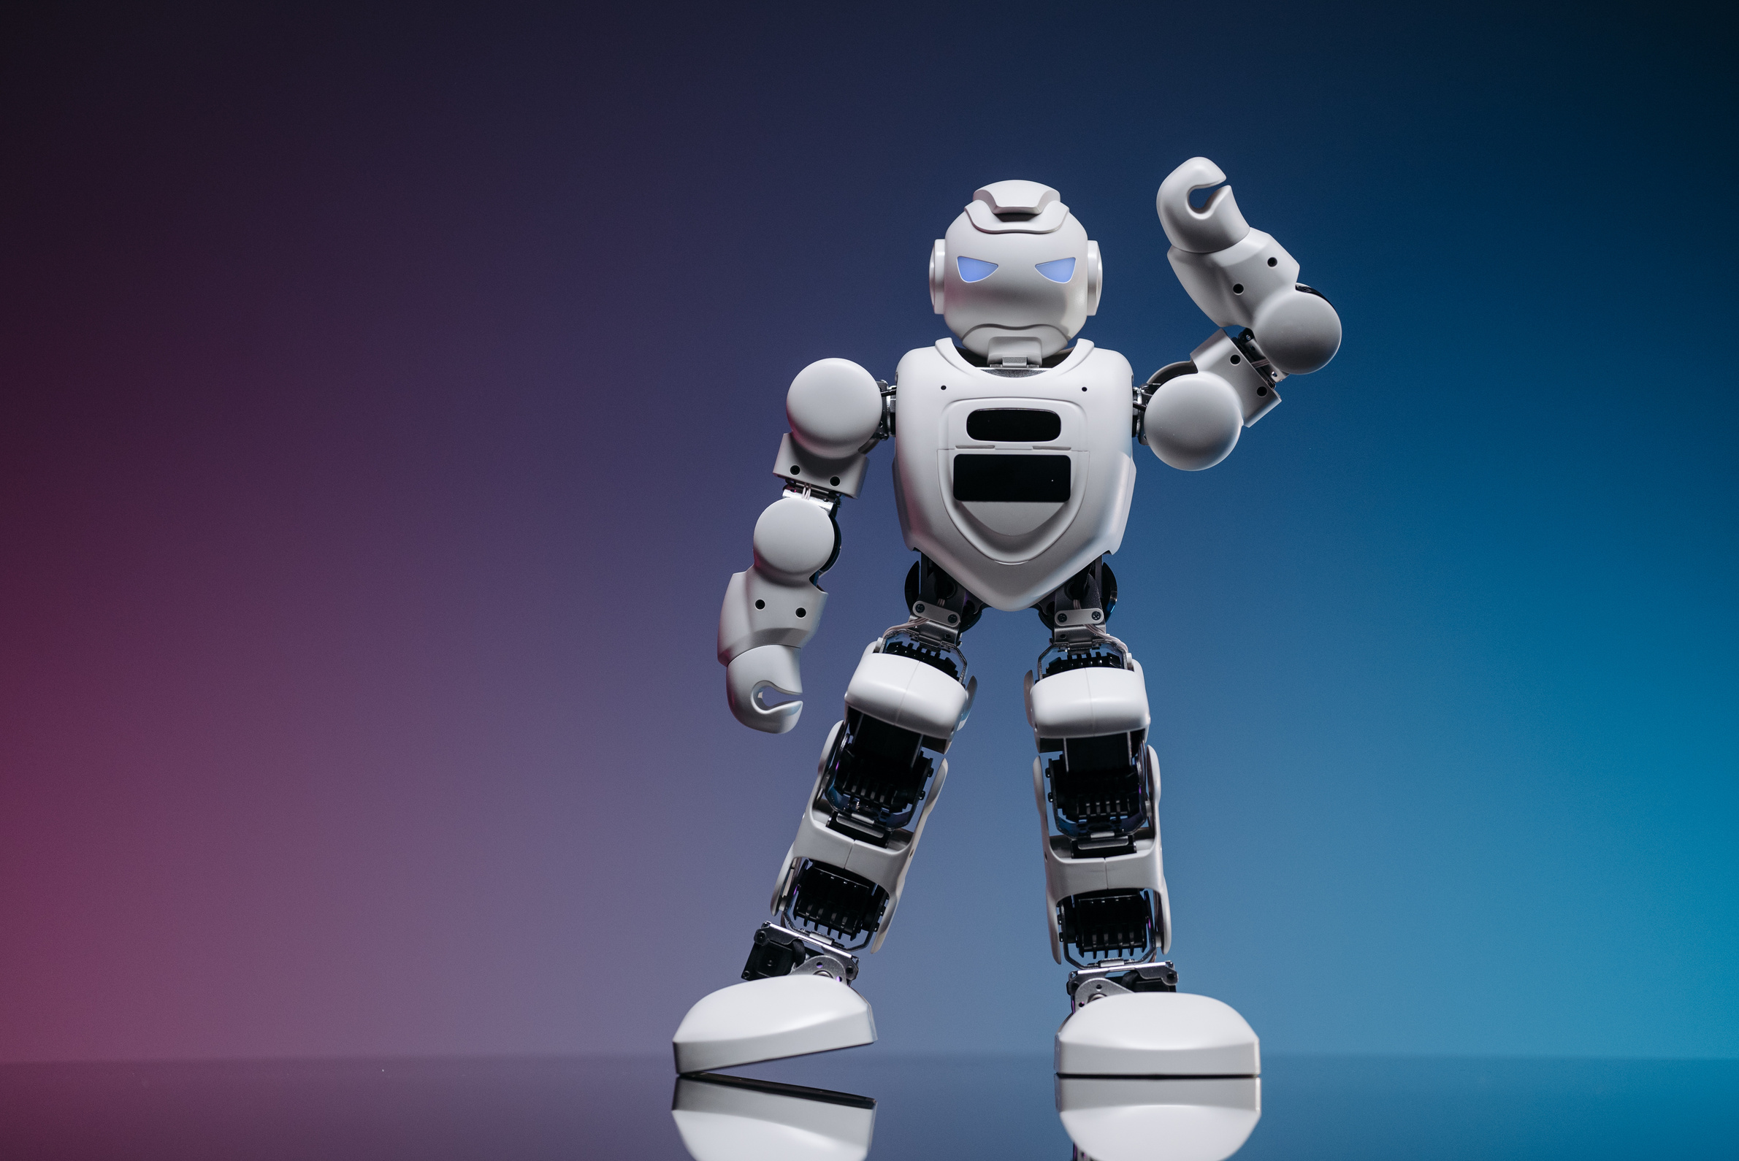

Impact & Future
Makes coding interview preparation more realistic
Helps users improve both technical and communication skills
Encourages learning through repeated practice and feedback
Can expand into a full AI interview coaching platform

Slide 6




The Team
Benjamin Shah
Cia Rodriguez
Ndemi Otieno
Isabel Mercado
CEO
Data Scientist
Product Manager
HR & Talent Acquisition

